Slide 1




NEXT GEN EMPLOYABILITY PROGRAM
Creating a future-ready workforce
Team Members
College Name
STUDENT NAME: AJITHKUMAR R
REGISTER NO: 511321205002
Kingston engineering college

Slide 2

CAPSTONE PROJECT SHOWCASE
Project Title
Building Bus Reservation System using Python and Django
Abstract | Problem Statement | Project Overview | Proposed Solution | Technology Used | Modelling & Results | Conclusion

Slide 3
Abstract
The Bus Ticket Reservation Project is a comprehensive web-based application designed to simplify and streamline the process of booking bus tickets for passengers while providing efficient management tools for bus operators. This project utilizes a combination of HTML, CSS, Python, Django, and SQLite3 to create a robust and user-friendly platform.
The key features of the Bus Ticket Reservation Project include user registration and authentication, bus route management, ticket booking, seat selection, payment gateway integration, booking management, user profiles, and an admin dashboard. Passengers can create accounts securely, search for available buses based on their preferred route, date, and time, select seats, and proceed to book tickets securely through the platform. They can also manage their profiles, view booking history, and update personal information.
Administrators have access to a centralized dashboard for monitoring and managing various aspects of the system, including bus route management, user management, ticket sales analytics, and system maintenance. They can add, edit, and delete bus routes, specify details such as departure times, destinations, and ticket prices, and view and manage bookings.
The Bus Ticket Reservation Project aims to enhance convenience for travelers by providing a user-friendly interface and efficient booking process while empowering bus operators with tools for efficient management and monitoring. By leveraging modern web technologies and user-centered design principles, the project seeks to improve the overall experience for passengers and bus operators alike in the bus ticket reservation process.
Source :

Slide 4
Problem Statement
Problem Statement: Enhancing Efficiency and User Experience in Bus Ticket Reservation
In the realm of bus ticket reservation systems, prevalent issues persist, hindering both passengers and service providers. Current platforms suffer from convoluted interfaces, insufficient route information, inefficient seat selection mechanisms, unreliable payment processing, and limited administrative functionalities. Passengers encounter frustration navigating complex interfaces, lack of route details, and suboptimal seat choices, while bus operators grapple with inefficient management and revenue loss.
Addressing these challenges requires the development of a modern, user-centric reservation application. This solution must prioritize intuitive interfaces, comprehensive route information, seamless seat selection, secure payment integration, and robust administration tools. By streamlining the booking process, providing detailed route information, facilitating intuitive seat selection, ensuring secure transactions, and empowering efficient management, the proposed application aims to revolutionize the bus ticket reservation experience for both passengers and service providers.
Through clear interfaces, extensive route details, interactive seat maps, reliable payment processing, and comprehensive administrative dashboards, this solution seeks to enhance efficiency, convenience, and satisfaction in the bus ticket reservation process. By embracing modern technology and user-centered design principles, the proposed application has the potential to set new standards in the industry and improve the overall experience for all stakeholders involved.
Source :

Slide 5
Project Overview
The Bus Ticket Reservation Application is a web-based platform designed to streamline the process of booking bus tickets for travelers. Utilizing HTML, CSS, Python, Django, and SQLite3, this application provides a user-friendly interface for both passengers and administrators.
1. User Registration and Authentication: Passengers can create accounts securely and log in to access the booking system, while administrators have access to additional functionalities for managing the system.
2. Bus Route Management: The system allows administrators to manage bus routes, including adding, editing, and deleting routes, as well as specifying details such as departure times, destinations, and ticket prices.
3.Ticket Booking: Passengers can search for available buses based on their preferred route, date, and time. They can then select seats and proceed to book tickets securely through the platform.
4. Seat Selection: Passengers can view available seats on buses and select their preferred seats based on availability, enabling them to choose their desired seating arrangements.
5. Payment Gateway Integration: Secure payment gateways are integrated into the application to facilitate online transactions for ticket purchases, ensuring a seamless and hassle-free booking experience for users.
6. Booking Management: Both passengers and administrators can view and manage bookings, including viewing booked tickets, cancelling bookings (if applicable), and generating booking confirmations.
7. User Profiles: Passengers can manage their profiles, view booking history, and update personal information, providing a personalized experience tailored to individual preferences.
8. Admin Dashboard: Administrators have access to a centralized dashboard for monitoring and managing various aspects of the system, including user management, ticket sales analytics, and overall system maintenance.
Source :

Slide 6
Proposed Solution
The Bus Ticket Reservation Project proposes the development of a modern, user-centric web application aimed at revolutionizing the process of booking bus tickets for passengers and enhancing management capabilities for bus operators.
This solution encompasses several key components.
1.User-Centric Interface: The application will feature an intuitive and easy-to-use interface for passengers, ensuring a seamless booking experience. Clear navigation, informative prompts, and visually appealing design elements will enhance user satisfaction and facilitate efficient booking.
2.Comprehensive Route Information: Passengers will have access to detailed information about available bus routes, including departure times, destinations, and ticket prices. This comprehensive data will enable informed decision-making and improve the overall booking experience.
Source :

Slide 7
3.Efficient Seat Selection Mechanisms: The application will employ interactive seat maps with real-time availability indicators, allowing passengers to select their preferred seats easily. Customizable seating preferences and intuitive seat selection processes will optimize passenger comfort and satisfaction.
4.Secure Payment Integration: Seamless integration with secure payment gateways will ensure reliable and hassle-free transactions for passengers. Robust security measures will be implemented to protect sensitive financial information and enhance trust in the booking process.
5.Advanced Administration Tools: The application will provide bus operators with a centralized dashboard for efficient management of routes, schedules, ticket inventory, and user accounts. Powerful analytics tools will enable data-driven decision-making and optimization of operational processes.
Source :

Slide 8
6.Notification System: Implementing a notification system will allow passengers to receive timely updates about their bookings, such as confirmation emails, reminders for upcoming trips, and notifications for any changes or cancellations. This proactive communication will enhance passenger satisfaction and reduce the likelihood of missed bookings.
Through the implementation of these key components, the Bus Ticket Reservation Project aims to address the current challenges faced by both passengers and bus operators in the booking process. By prioritizing user experience, comprehensive information, secure transactions, and efficient management tools, the proposed solution seeks to enhance efficiency, convenience, and satisfaction in the bus ticket reservation process for all stakeholders involved.
Source :

Slide 9


Technology Used
Front-end
Back-end
Source :

Slide 10
Modelling & Results
Modeling and Results for the Bus Ticket Reservation Application
Modeling:
1. Database Schema:
- The database schema includes tables for users, bus routes, bookings, and seats, with appropriate relationships established between them using foreign keys.
- Each table is designed to store relevant information, such as user details, route information, booking details, and seat availability.
2. User Interface Mockups:
- Mockups of the user interface depict the layout, design, and functionality of the application, including screens for user registration, route selection, seat selection, payment processing, and booking confirmation.
- The interface prioritizes usability, clarity, and responsiveness to ensure a seamless booking experience for passengers.
3. System Architecture:
- The system architecture outlines the overall structure of the application, including the front-end and back-end components, communication protocols, and data flow.
Source :

Slide 11
- Components such as the user interface, application logic, database management, and external integrations are identified and described.
Results:
1. User Registration and Authentication:
- Users can register securely using their email address and password, with authentication mechanisms implemented to ensure data security.
- Upon successful registration, users receive a confirmation email and can log in to access the booking system.
2. Bus Route Management:
- Administrators can add, edit, and delete bus routes, specifying details such as departure times, destinations, and ticket prices.
- Route information is stored in the database and displayed to passengers for selection during the booking process.
3. Ticket Booking and Seat Selection:
- Passengers can search for available buses based on their preferred route, date, and time, and select seats from an interactive seat map.
- Seat availability is updated in real-time, ensuring accurate booking information for passengers.

Slide 12
4. Payment Gateway Integration:
- Secure payment gateways are seamlessly integrated into the application, allowing passengers to make payments using credit/debit cards or other preferred methods.
- Payment processing is encrypted and secure, protecting sensitive financial information.
5. Booking Management:
- Passengers and administrators can view and manage bookings, including viewing booked tickets, cancelling bookings (if applicable), and generating booking confirmations.
- Booking details are stored in the database and updated dynamically as changes occur.
6. User Profiles and Administration Tools:
- Passengers can manage their profiles, view booking history, and update personal information through user-friendly interfaces.
- Administrators have access to a centralized dashboard for monitoring and managing various aspects of the system, including user management, ticket sales analytics, and system maintenance.
Overall, the Bus Ticket Reservation Application demonstrates effective modeling and delivers tangible results in enhancing efficiency and user experience in the bus ticket reservation process. Through intuitive interfaces, seamless functionality, and robust security measures, the application offers a reliable and convenient solution for passengers and bus operators alike.

Slide 13
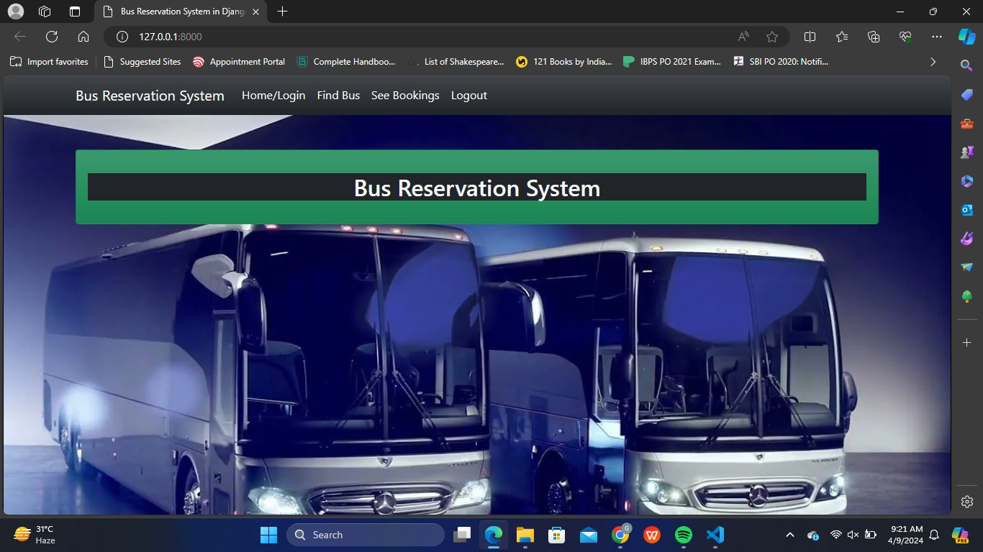
Homepage

Slide 14
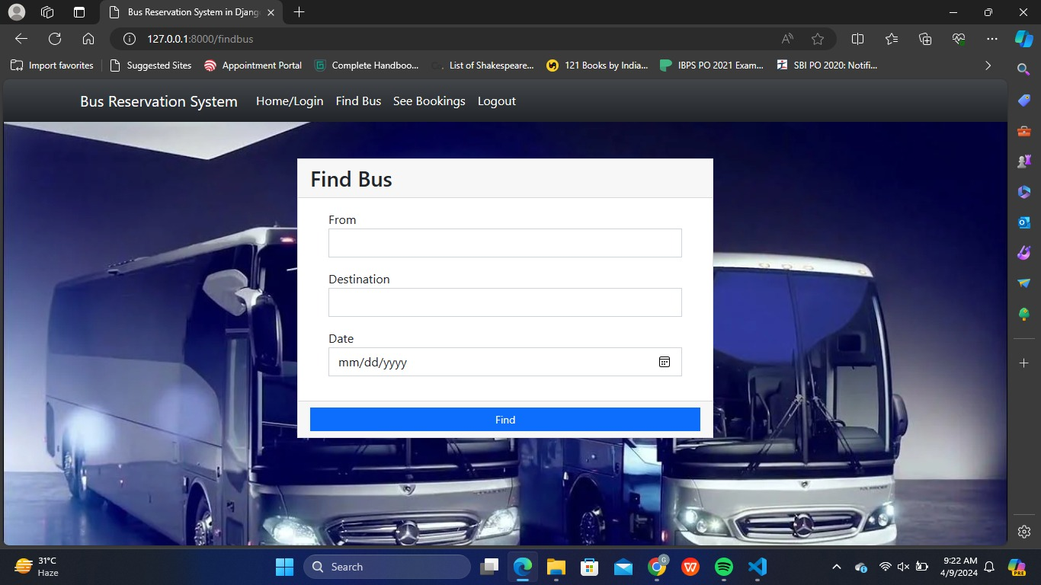
About-Us-Page

Slide 15
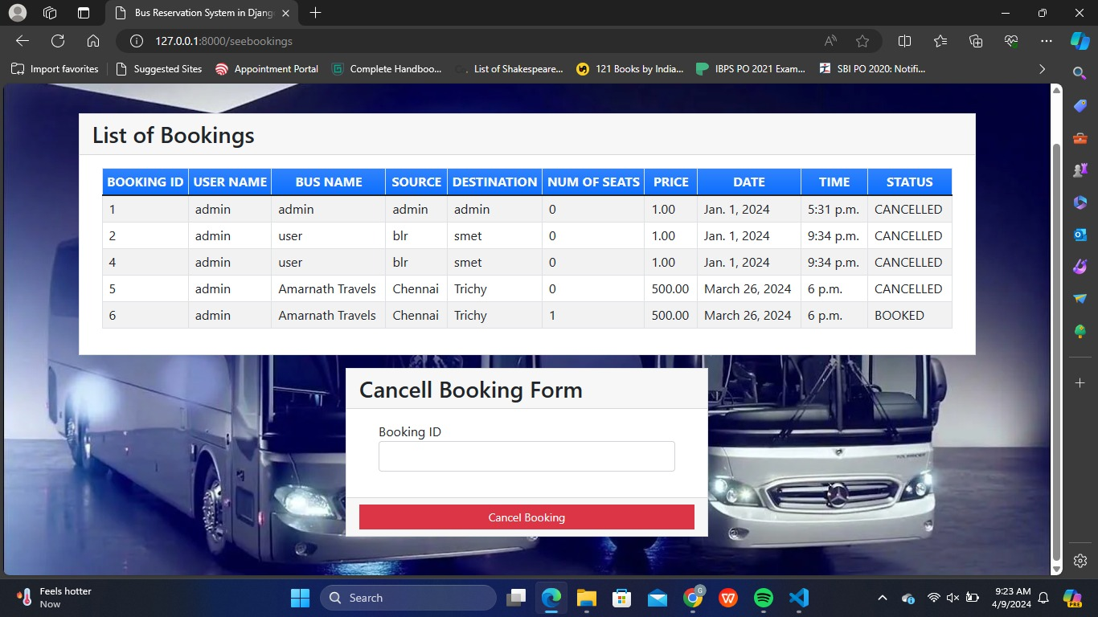
Service-Page

Slide 16
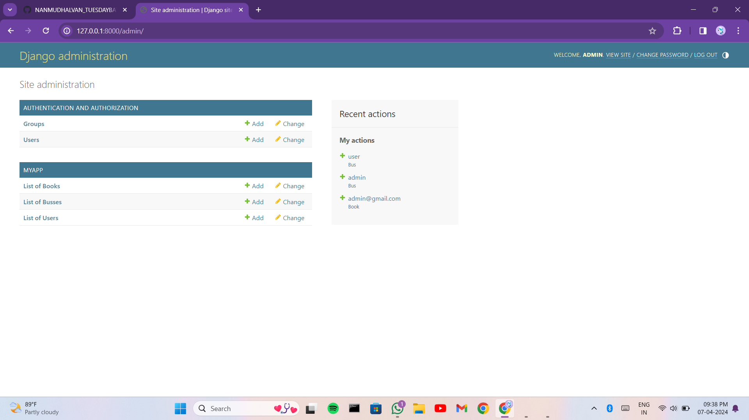
Departments-Page

Slide 17
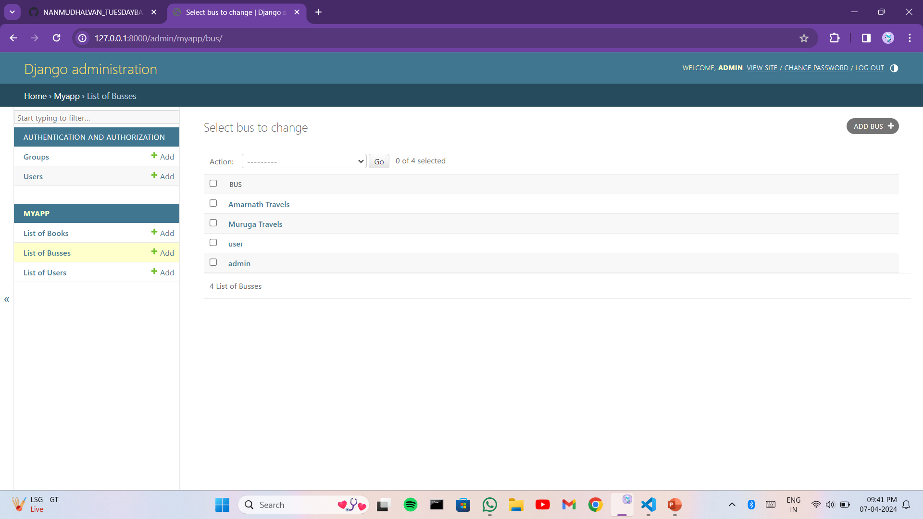
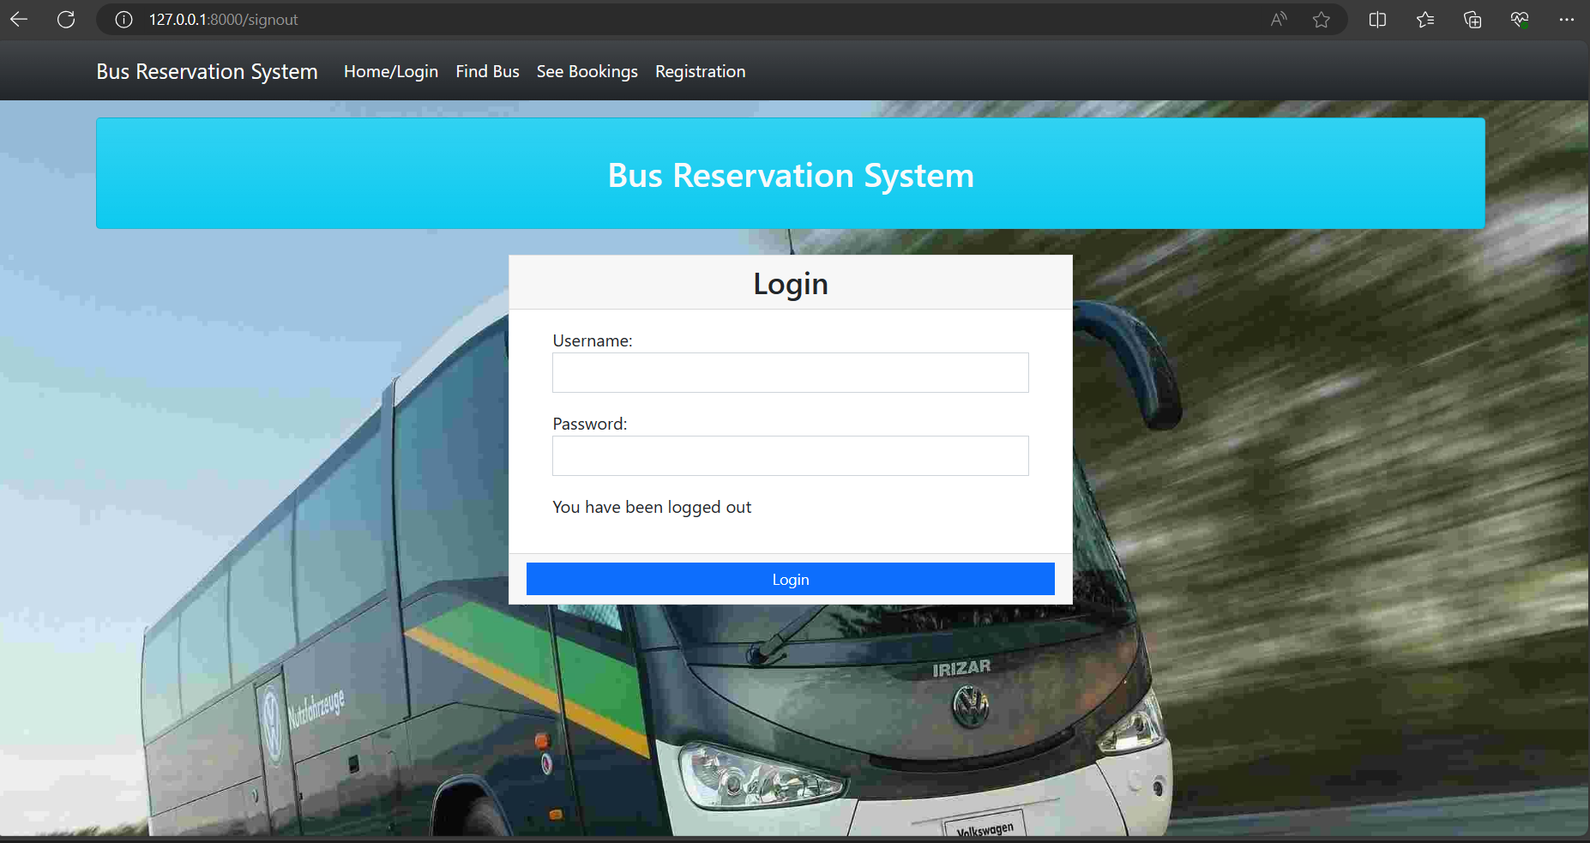
Blog-Page

Slide 18
Future Enhancements:
Certainly! Here are some potential future enhancements that could be implemented for a bus reservation application:
1.Real-Time Tracking: Integrate GPS technology to allow users to track buses in real-time. This feature could help passengers plan their journeys more effectively and reduce wait times at bus stops.
2.Dynamic Pricing: Implement dynamic pricing algorithms that adjust ticket prices based on factors such as demand, time of booking, and availability of seats.
3.Integration with Payment Gateways: Offer a variety of payment options including credit/debit cards, mobile wallets, and net banking to facilitate seamless transactions.
4.Multi-Language Support: Enable multi-language support to cater to a wider audience, especially in regions with diverse linguistic backgrounds.

Slide 19
Conclusion
In conclusion, the development of a bus ticket reservation application using HTML, CSS, Python, Django, and MySQLite3 presents a robust and versatile solution for managing bus bookings effectively. Through the integration of these technologies, the application can offer a user-friendly interface, seamless booking process, and efficient data management.
HTML and CSS provide the foundation for creating a visually appealing and responsive user interface, ensuring that passengers can easily navigate the application across different devices. JavaScript enhances the interactivity of the application, enabling dynamic features such as form validation and interactive elements.
Overall, the integration of HTML, CSS, Python, Django, JavaScript, and MySQLite3 empowers the bus ticket reservation application to provide a streamlined and efficient booking experience for passengers while offering administrators the tools they need to manage operations effectively. With continuous updates and enhancements, the application can remain competitive and meet the evolving needs of the transportation industry.
Source :

Slide 20
Thank You!
Notes:
Thank You !!

